Slide 1
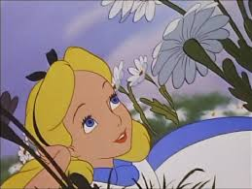
Alice in Wonderland
By the students of 3a

Slide 2
Presentation
This year we celebrate the 150° anniversary of “Alice Adventures in Wonderland”.
The English author Charles Lutwidge Carroll under the pseudonym Lewis Carroll wrote this book in 1865.
For the 150 years of the original book were printed 88 new copies of the famous book.

Slide 3
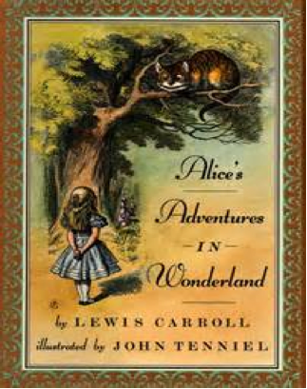
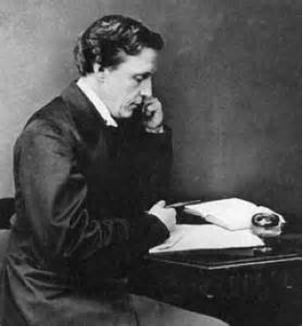
Author
Lewis Carroll was an English writer, mathematician, logican, anglican deacon and photographer. He was born on the 27th of January 1832 and he died on the 14th January 1898. He wrote a lot of examples of the genre of literary nonsense and he was noted for his facility at word play, logic and fantasy. He loved Alice so much and he devoted his book to Alice.

Slide 4
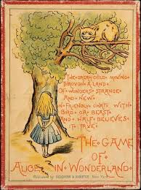
Plot
At the beginning Alice was under a tree on the bank of a river and she was bored because she didn't have nothing to do, but suddenly she saw a white rabbit who looked very strange, it had pink eyes, waistcoat with a clock.Then Alice followed the rabbit until a large rabbit-hole and she slide into it and she fell down in the darkness.
When she landed she saw a table with above a key and a little bottle, then she drank it and she became small but she forgot the key on the table so she ate a little cake and she became bigger, then Alice was unhappy so she started cry so much that she can swim in her tears, suddenly the rabbit arrived and he dropped a pair of gloves and a fan so Alice took it and she became smaller.

Slide 5
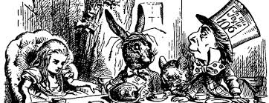
Then the Mouse and other strange creatures arrived and they ran confusedly. Alice began to walk and she arrived in a grass with a big mushroom with on the top the Caterpillar who was smoking hookah, then she met the Cheshire Cat into the forest.Then she went to the house of the Duchess. Then she went to the March Hare who was drinking a cup of tea with the Mad Hatter and the dormouse, after this she discovered the way to the castle of the Queen of Hearts and she was invited for a game of croquet. Then it was a process, after this Alice returned as big as she was at the beginning and the story finishes with her who woke up and went home for drinking some tea.

Slide 6
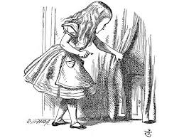
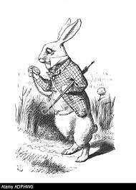
Characters
Alice
The seven years old protagonist who belives in fantastic adventures, she is brave, curious and friendly with the others animals and creatures, she has a cat and a sister and she really likes adventures and she is brave.
The White Rabbit
He leeds Alice to Wonderland, he always dress a waistcoat, a clock and a white pair of gloves, he has pink eyes and he is maniac, timid and occasionaly aggressive.

Slide 7
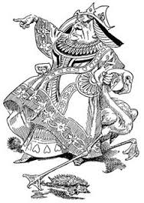
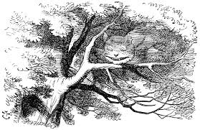
The Queen of Hearts
She is the ruler of Wonderland, she is severe and domineering, and she screams a lot for her subjects to be behaded and she loves red roses.
The Cheshire Cat
He appears and disappears on a tree in the forest and he explains Wonderland's madness to Alice.

Slide 8
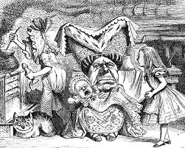
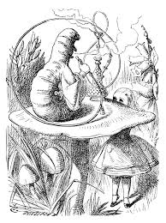
The Duchess
She is the cousin of The Queen and she behaves rudely to Alice at first but then she is more considerable.
The Caterpillar
He sits on a mushroom, smokes a hookah and he directs Alice to the magic mushroom.

Slide 9
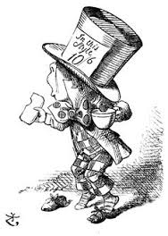
The Mad Hatter
A small hatter who lives in perpetual
tea-time, he enjoys frustrating Alice.
The March Hare and The Dormouse
They're companions of tea-time and they like frustrating Alice.

Slide 10
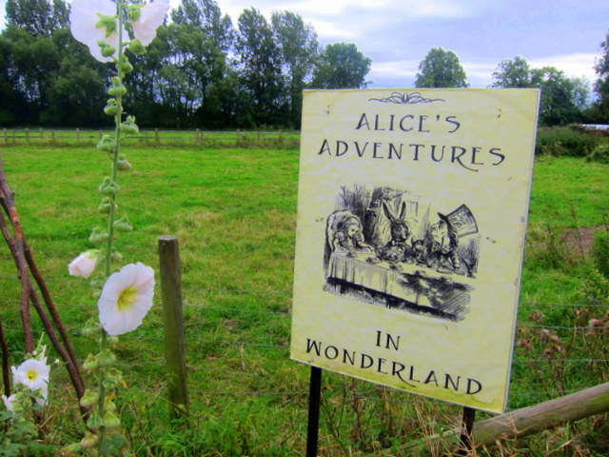
The Gender
Lewis Carroll wrote Alice Adventures in Wonderland in 1865, it is a fantastic nonsense wonderful novel.
The theory of the book is that a summer day three girls were on a boat on the Thames; the travel began at Folly Bridge(Oxford) and it finished at Godstow and Carroll told them a story and then Alice asked him to write and publish it.
It 150° anniversary is celebrated this year with a lot of festivals and expositions, it is a very important year for world's literature.

Slide 11
And finally…
This presentation it has been realized by the students of class 3°a of the Secondary School, Collegio Gallio.
We thank you for your cooperation and for looking at our small but great job.

