Slide 1
SHAKESPEARE’S SONNETS & PLAYS
Classe IV Liceo Linguistico
A.S. 2014 -2015

Slide 2
William Shakespeare

Slide 3
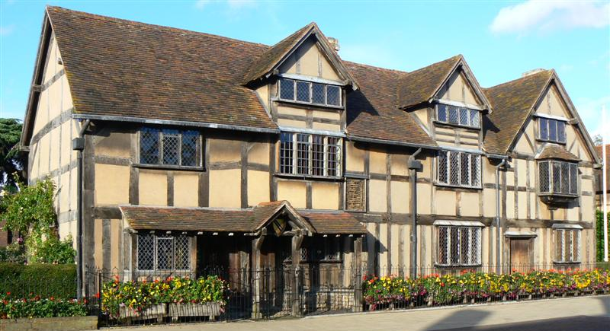
William Shakespeare’s birthplace, Stratford-upon-Avon

Slide 4
What is a sonnet
A sonnet is a 14-line poem in Iambic Pentameter.
A sonnet must follow a specific rhyme scheme, depending on the type of sonnet.
A line of Iambic Pentameter is a line with ten beats.
A “Iamb” is two beats, or one “foot”.
“Penta” is five (a line has five “feet”).
“Meter” is the rhythm of the poem.
A “foot” is made of an unstressed syllable and a stressed syllable (in that order).

Slide 5
The English Sonnet vs. The Petrarchan Sonnet
The Petrarchan sonnet (or Italian sonnet) and the English sonnet differ not only in their respective formal structures, but also in the way their content is ordered by the introduction of the turn (volta).
The Petrarchan Sonnet consists of an eight-line octave followed by a six-line sestet.
Thomas Wyatt divided his sonnets into three quartets and a final couplet. Wyatt employed the Petrarchan octave, but his most common sestet scheme is cddc ee.
Edmund Spencer introduced the rhyme pattern abab – bcbc to the initial octave.

Slide 6
Thus, a structural feature of the English Sonnet is the final couplet, which also has an effect on how the poem’s content is ordered.
In the Petrarchan Sonnet the volta, meaning the division or break, in the sonnet’s content occurs between the eight-line octave and the following six-line sestet; the turn of the English Sonnet usually comes with the final couplet.

Slide 7
Rhyming pattern of Shakespearian sonnets
The Shakespearean sonnet has three quatrains followed by a couplet. The ryhme scheme is: abab cdcd efef gg.
Example : sonnet CXXX:
My mistress' eyes are nothing like the sun; a Coral is far more red than her lips' red; b If snow be white, why then her breasts are dun; a If hairs be wires, black wires grow on her head. b
I have seen roses damasked, red and white, c But no such roses see I in her cheeks; d And in some perfumes is there more delight c Than in the breath that from my mistress reeks. d
I love to hear her speak, yet well I know e That music hath a far more pleasing sound; f I grant I never saw a goddess go; e My mistress, when she walks, treads on the ground: f
And yet, by heaven, I think my love as rare g As any she belied with false compare. g

Slide 8
Sonnet CXXX: a very modern and original one
Gli occhi della mia signora non sono in nulla simili al sole ;
Il corallo è molto più rosso delle sue rosse labbra;
Se la neve è bianca, perchè il suo seno è grigiastro; Se i capelli sono setole, nere setole le crescono in testa.
Ho visto rose screziate, rosse e bianche, Ma non vedo simili rose sulle sue gote; E alcuni profumi sono più delicati dell’alito che emana dalla mia signora.
Mi piace sentirla parlare, tuttavia riconosco che la musica ha un suono assai più piacevole; Ammetto di non aver mai visto una dea camminare; La mia signora, quando cammina, calpesta il suolo:
E tuttavia, in nome del cielo, penso che il mio amore sia tanto prezioso
Come qualsiasi donna falsamente decantata.

Slide 9
How many sonnets did Shakespeare write?
Shakespeare wrote 154 sonnets, likely composed over an extended period from 1592 to 1598.

Slide 10
1609: year of the sonnets’ publication by Thomas Thorpe
The text of Shakespeare's sonnets generally considered to be definitive is that of the 1609 edition, which was published by Thomas Thorpe without the author's permission.
Thorpe's edition, titled “Shake-speare's Sonnets: Never Before Imprinted”, is referred to today as the "Quarto," and is the basis for all modern texts of the sonnets.

Slide 11
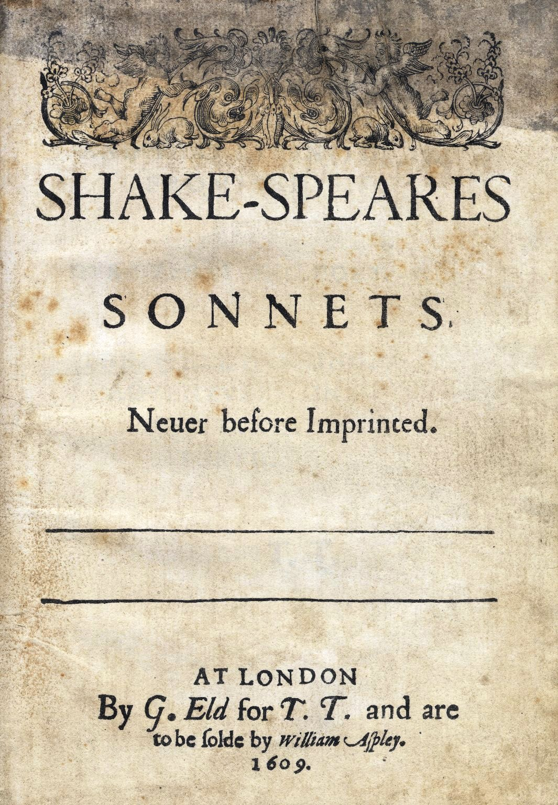

Slide 12
Shakespeare’s sonnets are usually divided in three clear groupings: sonnets 1 to 126 are addressed to a young man; sonnets 127-152 are addressed to, or concern, a dark lady (dark in the sense of her hair, her facial features, and her character), and sonnets 153-154 are fairly free adaptations of two classical Greek poems.
Among the most popular of Shakespeare’s sonets are sonnets XII, XVIII and CXXX.

Slide 13
The sonnets have the feel of autobiographical poems, but we don’t know whether they deal with real events or not, because no one knows enough about Shakespeare’s life to say whether or not they deal with real events and feelings.

Slide 14
When I Do Count The Clock, sonnet XII
When I do count the clock that tells the time,
And see the brave day sunk in hideous night;
When I behold the violet past prime,
And sable curls all siver’d o’er with white;
When lofty trees I see barren of leaves,
Which erst from heat did canopy the herd,
and summer’s green all girled up in sheaves,
Borne on the bier with white and bristly beard,
Then of thy beauty do I question make,
That thou among the wastes of time must go,
Since sweets and beauties do themselves forsake
And die as fast as they see other grow;
And nothing ’gainst Time’s schyte can make defence
Save breed, to brave him when he takes thee hence.
Quando conto l’orologio che racconta il tempo,
E vedo il giorno superbo sprofondato nell’odiosa notte;
Quando osservo la viola non più in fiore,
E riccioli neri tutti inargentati di bianco;
Quando alberi sublimi vedo nudi di foglie
Che già al gregge schermarono la calura,
E il verde dell’estate, stretto in covoni,
Portato sul carro con bianca e ispida barba;
Allora sulla tua bellezza mi vado interrogando,
Che tra i resti del tempo te ne dovrai andare,
Perché dolcezze e bellezze smarriscono se stesse
E muoiono veloci come ne vedono altre crescere veloci;
E niente contro la falce del Tempo può offrire difesa,
Se non la prole che lo sfidi, quando ti toglierà di qui.

Slide 15
When I Do Count The Clock
It is the twelfth of a group of 17 sonnets dedicated
to the ‘’fair youth’’
and called ‘marriage sonnets’,
because in them the poet invites him to marry and beget children,
This sonnet explains some of the themes of Shakespeare’s collection:
1. the destructive power of the passing of time connected with :
2. death , which can only be opposed by:
3. marriage and procreation

Slide 16
When I Do Count The Clock: Structure & Themes
First quatrain -A-B-A-B
-theme: the passing of time and the decay of natural things
Second quatrain -C-D-C-D
-theme: the passing of time and the decay of natural things
Third quatrain -E-F-E-F
-theme: death
Couplet -G-G
-theme: procreation: the only ‘’defence’’ against death and decay
Repetition of words: ‘’when’’, ‘’and’’, ‘’time’’
The final couplet summarizes the meaning of the whole sonnet with a metaphor = «the Time’s scythe»

Slide 17
Shall I Compare Thee to a Summer’s Day, sonnet XVIII: the eternizing power of poetry
Shall I compare thee to a summer’s day?
Thou art more lovely and more temperate.
Rough winds do shake the darling buds of May,
And summer’s lease hath all too short a date:
Sometime too hot the eye of heaven shines,
And often is his gold complexion dimm’d,
And every fair from fair sometime declines,
By chance, or nature’s changing course untrimm’d,
But thy eternal summer shall not fade,
Nor lose possession of that fair thou ow’st,
Nor shall death brag thou wander’st in his shade,
When in eternal lines to time thou grow’st,
So long as man can breath, or eyes can see,
So long lives this, and this gives life to thee.
Dovrò paragonarti a un giorno d’estate?
Tu sei più amabile e più temperato:
Rudi venti scuotono i diletti boccioli del maggio
E l’affitto dell’ estate ha durata troppo breve;
Talvolta troppo caldo l’occhio del cielo splende
E spesso l’oro del suo volto è offuscato;
E ogni bellezza dalla bellezza prima o poi declina,
Spogliata dal caso o dal mutevole corso della natura.
Ma la tua eterna estate non dovrà svanire
Né perdere possesso di quella bellezza che è tua,
Né la morte si vanterà che tu vaghi nella sua ombra, quando in versi eterni tu crescerai nel tempo.
Finché uomini respireranno o occhi vedranno,
fin tanto vivrà questa poesia, e questa darà vita a te.

Slide 18
Features of drama
The essence of a play is its performance on the stage, where the story is acted through the words and gestures of actors in front of an audience.
A play is usually divided into a certain number of acts or scenes; each act can have one or more scenes.
The structure of Shakespeare’s plays is usually:
Act I: Introduction
Act II: Development
Act III: Turning point or crisis
Act IV: Complication
Act V: Resolution
The oldest and the most popular form of drama is tragedy. A tragedy is a dramatic work in which events move to a fatal or disastrous conclusion. Characters are heroes or heroines, their language is poetic.
The opposite of tragedy is comedy, which is traditionally a humorous play always characterized by a happy ending; the characters are usually ordinary people set in everyday situations, their language is prosaic.

Slide 19
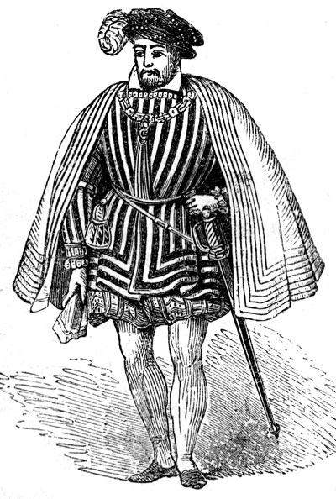
Renaissance drama (I)
The Elizabethan theatre was the most relevant cultural phenomenon in Renaissance England and was also popular entertainment seen by great nobles, burghers, craftsmen.
Considering that the actors were in close contact with the audience, the continuous interchange between the actors and the spectators and the composite quality of the audience give account for the unique atmosphere of the Elizabethan public theatres.
The companies of players
The continuing rise of the popularity of plays led to a change in the conditions of the players. At the beginning, they were classified as “vagabonds” and were forbidden to perform in public.
For this reason, they put themselves under the protection of some nobleman.
Players often performed at Court or for noble households
Female roles were acted by young boys disguised as girls or women. .

Slide 20
Renaissance Drama (II)
It is based on Seneca’s Latin tragedies, rather than on Greek classic ones. This gave birth to the revenge tragedies, also called Spanish tragedies, where the hero’s quest of vengeance leads to scenes of extreme violence.
Together with William Shakespeare, Christopher Marlowe wrote plays about the many sides of human nature and England’s history, mixing the highly formal of the tragedy with the popular of the comedy.

Slide 21
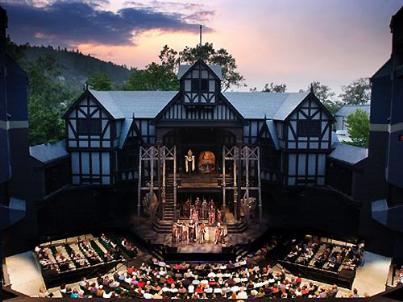
The Structure of the Theatre Public Outdoor Playhouses
At first the companies of players performed in the countryards of the London inns.
Then, many new public outdoor playhouses were built.
North of the City:
South of the City:
THE THEATRE
THE CURTAIN
THE ROSE
THE SWAN
THE GLOBE
In 1574 public performances were banned

Slide 22
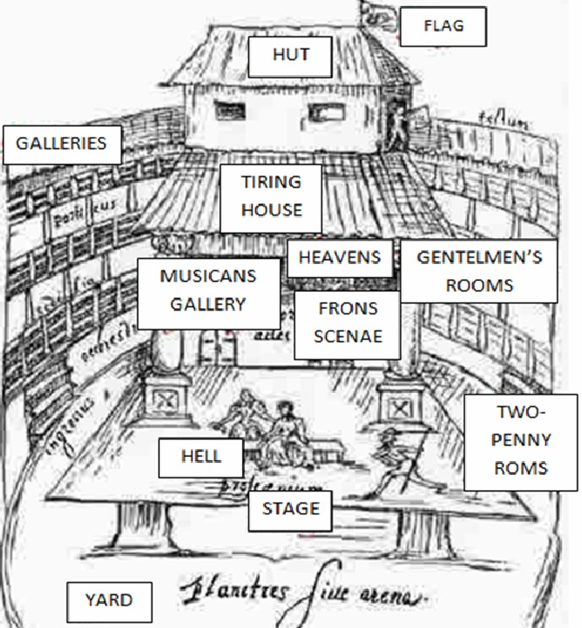
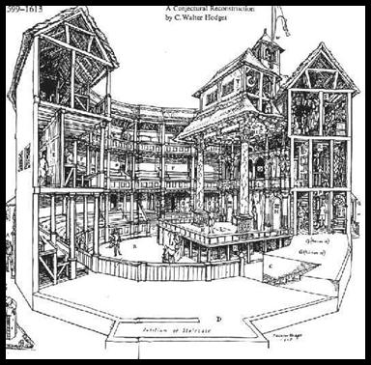
Standing spectators were called ‘Groundlings’
1 penny: stand in the ARENA
2 pence: access to the GALLERIES
Plays were performed
in the afternoon
The actors were in close contact
with the audience,
who would move around, chat, quarrel, eat and drink

Slide 23
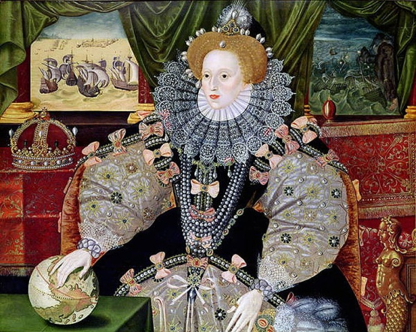
The Elizabethan and the Jacobean theatre
After Elizabeth’s death there was a sharp division between
public outdoor theatres and private indoor ones.
The lower and the higher classes
were no longer part of the same audience.

Slide 24
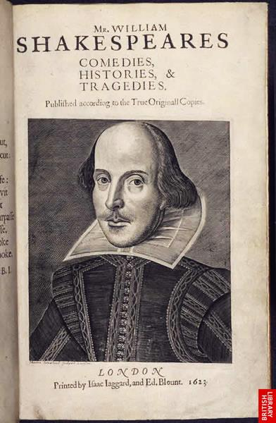
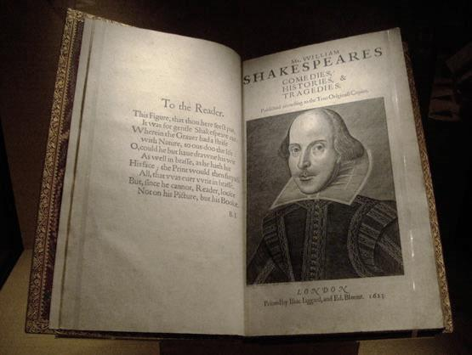
Shakespeare’s plays: First Folio

Slide 25
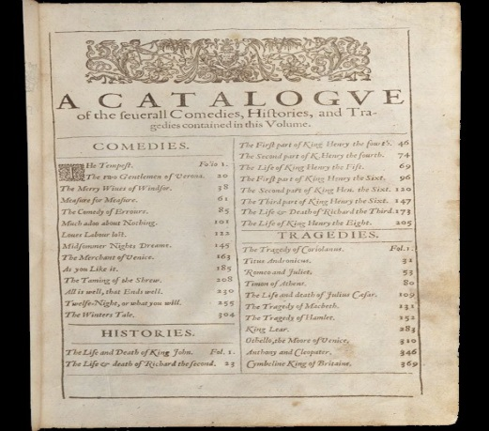
First Folio
Came out in 1623
Folio means a large sized volume
It contains all the 38 plays which are attributed to Shakespeare
Shakespeare’s plays are not given in chronological order, but according to genre: comedies, historical plays and tragedies.
Since we do not know when every play was written, we have to guess the date of a play taking into account external and internal evidence.

Slide 26
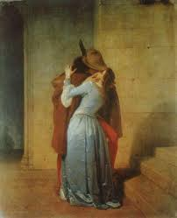
Shakespeare’s plays: themes
WOMEN AND LOVE: obsessive desire for love
Romeo and Juliet
WOMEN AND POWER: heroines do not display stereotyped female behaviour and poses, but their desire for power is often the driving force of the play
Macbeth
FATHERS AND DAUGHTERS: contrast between them, daughters are not weak submissive creatures
The Merchant of Venice, Romeo and Juliet, King Lear
RETHORIC AND POWER: plays contain at least one rhetorical speech central to the meaning of the play. Rhetoric is never merely decorative and also contains a great potential for evil.
Hamlet: «To be or not to be»
THE WORLD AS A STAGE: a metaphor both modern and universal, common in Renaissance culture: life is a play and the world is its stage.
Notes:
FONTI: Millennium Concise, Arturo Cattaneo, Donatella de Flavis
Google images
26

Slide 27
Short glossary of rhetoric (I)
alliteration
repetition of the same initial consonant sound throughout a line of verses
antithesis
juxtaposition, or contrast of ideas or words in a balanced or parallel construction
assonance
repetition or similarity of the same internal vowel sound in words of close proximity
chiasmus
two corresponding pairs arranged in a parallel inverse order
ellipsis
omission of one or more words, which are assumed by the listener or reader

Slide 28
Short glossary of rhetoric (II)
hyperbaton
altering word order, or separation of words that are normally associated, for emphasis.
metaphor
implied comparison between two unlike things achieved through the figurative use of words
paralipsis
emphasizing a point by seeming to pass over it
parallelism
similarity of structure in a pair or series of related words, phrases, or clauses
personification
things or inanimate entities in general are treated as though they were human beings
simile
an explicit comparison between two things using "like" or "as“

Slide 29
Phases of Shakespeare’s career
The first period (pre-1594) has its roots in Greek, Roman and medieval English drama — the plays show a certain obviousness. It's possible that Shakespeare was influenced by Christopher Marlowe — now considered Shakespeare's greatest literary rival . The years of apprenticeship.
The second period (1594–1600) shows a clearly maturing author, and the plays are less labored and predictable. He experiments with blending comedy and tragedy, considered a trademark of Shakespeare‘s. The history plays and the love comedies.
The third period (1600–1608) marks the great tragedies. At this point he wrote the plays that would earn him his place in history. Lear, Hamlet, Macbeth, and Othello are classic tragic protagonists in the best dramatic sense. The comedies, meanwhile, grow moody and ambiguous. The great tragedies and the dark comedies.
The last period is one of deep symbolism. At the end of his career, and facing middle age, Shakespeare seemed preoccupied with stories of reconciliation and redemption. The “Romances”.

Slide 30
Hamlet’s monologue
Act III, scene I – Hamlet’s Soliloquy
http://www.youtube.com/watch?v=xYZHb2xo0OI video acted by David Tennant
audio acted by 4LL students
SCENE: As King Claudius and Polonius observe him from behind an arras (arazzo), Hamlet seems to contemplate suicide.
HAMLET: To be, or not to be -- that is the question: Whether 'tis nobler in the mind to suffer The slings and arrows of outrageous fortune, Or to take arms against a sea of troubles, And, by opposing, end them. To die, to sleep-- No more--and by a sleep to say we end The heartache and the thousand natural shocks That flesh is heir to - 'tis a consummation Devoutly to be wished. To die, to sleep-- To sleep--perchance to dream. Ay, there's the rub, For in that sleep of death what dreams may come

Slide 31
When we have shuffled off this mortal coil
Must give us pause. There's the respect
That makes calamity of so long life.
For who would bear the whips and scorns of time,
Th' oppressor's wrong, the proud man's contumely,
The pangs of dizprized love, the law's delay, The insolence of office, and the spurns
That patient merit of th'unworthy takes,
When he himself might his quietus make With a bare bodkin? Who would fardels bear, To grunt and sweat under a weary life,
But that the dread of something after death, The undiscovered country from whose bourn
No traveller returns, puzzles the will And makes us rather bear those ills we have Than fly to others that we know not of?
Thus conscience does make cowards of us all,
And thus the native hue of resolution
Is sicklied o'er with the pale cast of thought,
And enterprises of great pitch and moment
With this regard their currents turn awry
And lose the name of action.

Slide 32
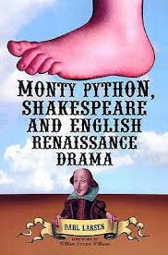
Shakespeare’s modernity

Slide 33
Shakespeare’s universality and modernity
Shakespeare’s greatness consists in his universality and modernity. The themes Shakespeare deals with are universal: love, struggle for power, opposition of young generation to the older.
His modernity is in the deep analysis of the human nature.
Hamlet is perhaps the closest of Shakespeare’s heroes to modern sensibility, he has full self- consciousness and shows doubts, indecisions and frailties typical of the modern man.

Slide 34
Bibiografia e Sitografia
A. Cattaneo, D. De Flavis – Millennium Concise – C. Signorelli Scuola, 2012
S. Maglioni, G. Thomson - Literary Hyperlinks – Black Cat, 2012
Webster’s Encyclopedic Unabriged Dictionary of the English Language
Google images
Youtube videos
www.netplaces.com/shakespeare/
www.shakespeare-online.com/sonnets/
www.william-shakespeare.info
www.worldofteaching.com
www.shakespeare.org.uk
www.en.wikipedia.org

